Slide 1
Continuum of Care Support Model
Red Lake Nation Filling on the Gaps

Slide 2
Red Lake’s Response to Community, Programs and Leadership Meetings
Identified Issues around Substance Abuse
Overdoses on the Rise
Need Different Types of Programs for Meeting Members where they are
Lack of Housing
Programs to Combat Issues
Detox Center – Wellness Care Unit
MARS program expansion, new building
New Treatment Center in Red Lake
Congregate Homeless Shelter for those with Substance Abuse issues
Supportive Housing Unit
Sober Village

Slide 3
Tribal Member
Congregate
Shelter
MARS
Dosing Program
Detox/
Wellness Care Unit
Treatment Center
Chemical Health Program
Supportive Housing Unit
Sober Village

Slide 4
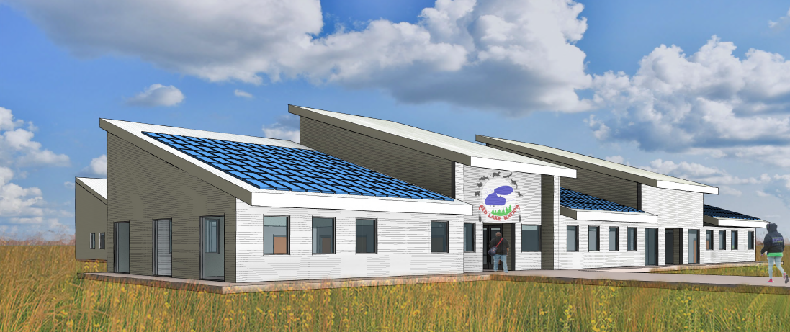
Congregate Shelter
3 levels of support, crisis, transitional and sober living
72 Beds
16,500 sq. feet building
Project Cost $10 Million
DHS Rural Grant Submitted on 9-21-23
IF awarded, Project Begins 2024

Slide 5
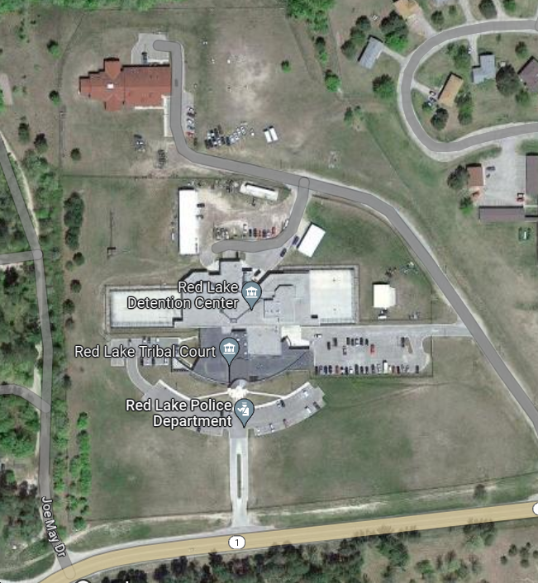
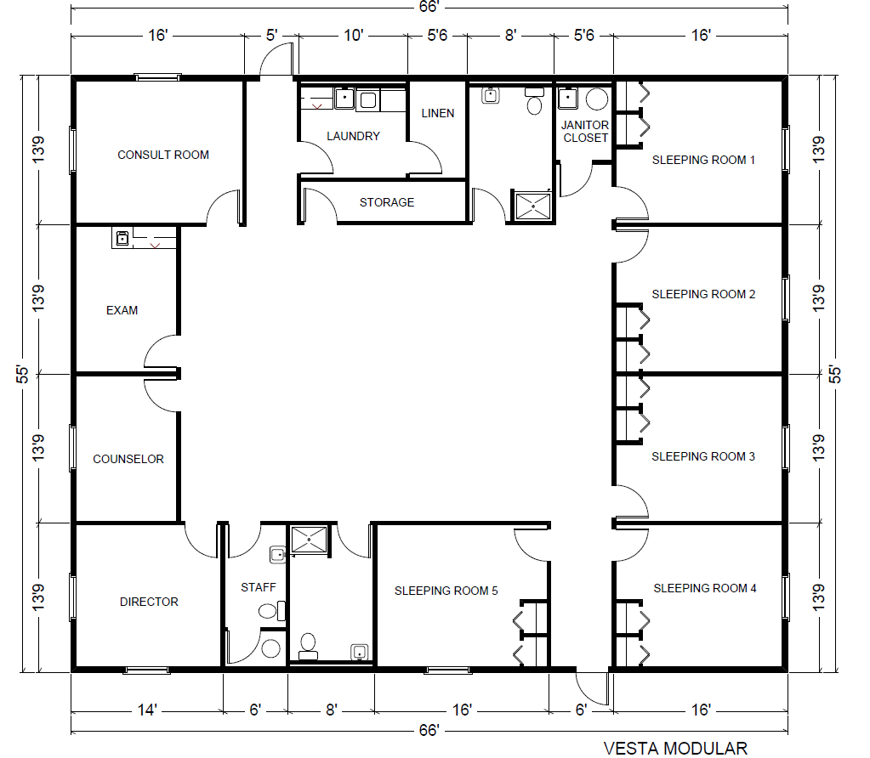
Detox Treatment – Wellness Care Unit
Conceptual Building Layout
5 sleeping rooms
3630 sq. feet, Module Unit
Projected 2024 Project
Potential Location, Next to Red Lake’s Justice Center
X

Slide 6
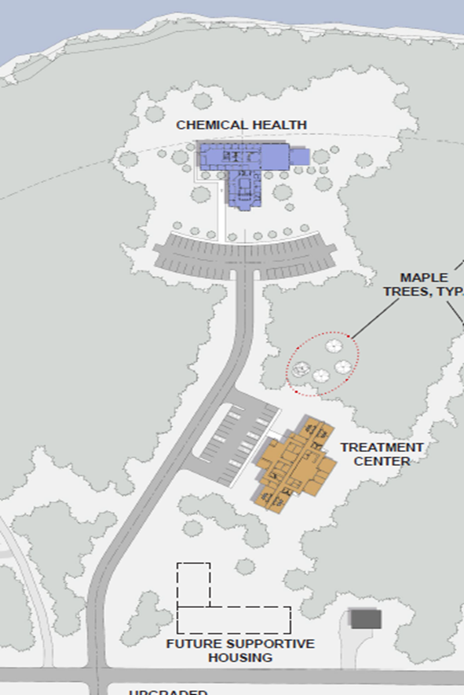
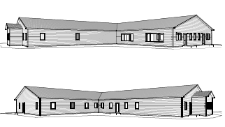
New MARS Program Building
Dosing Program
8,800 sq. feet, Modular Unit
Services 55 tribal members
Project Cost $2.5 Million, internally funded
Phase 1 of 3 building for this site

Slide 7
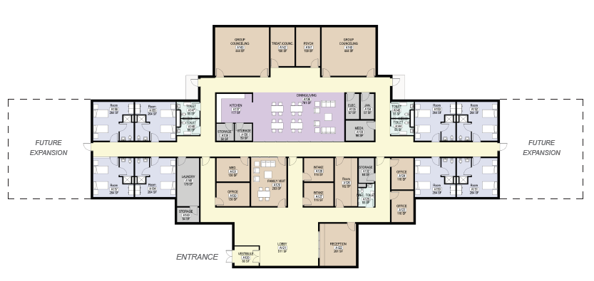
New Red Lake Treatment Center
16 Bed Unit
18,000 sq. feet
Phase 2 of 3 for Buildings
Project Estimate $5-7 Million, 50% internal funds and 50% loan options
Depending on Funding Source 2024 -2025 start time

Slide 8
Supportive Housing Project
Identified Space
24 Bed Unit
Support Services on Site
Workforce Assist Programming
Transitional – No Time Limit
Researching options for funding
Phase 3 of 3 for Building on Site

Slide 9
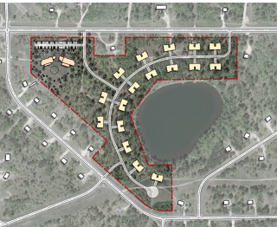
Sober Village
Duplex, Triplex and Four-plex Housing options
House Projections 50+ Members and Families
Supportive Service Programs on Site
Conceptual Site Plan
Researching Modular Units vs Stick Build
Researching Options for Funding

Slide 10
Questions ?

